Slide 1
MFE CLASS OF 2022
RESUMES

Slide 2
Step one: resume

Slide 3
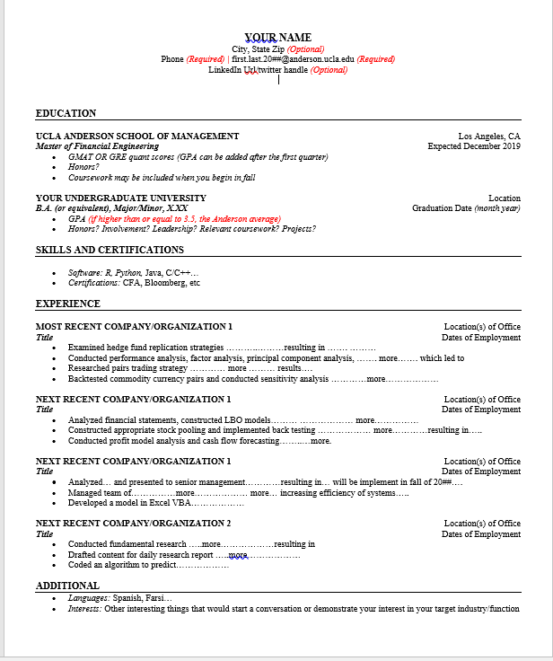
MFE Anderson template
Handouts will be emailed to you.

Slide 4
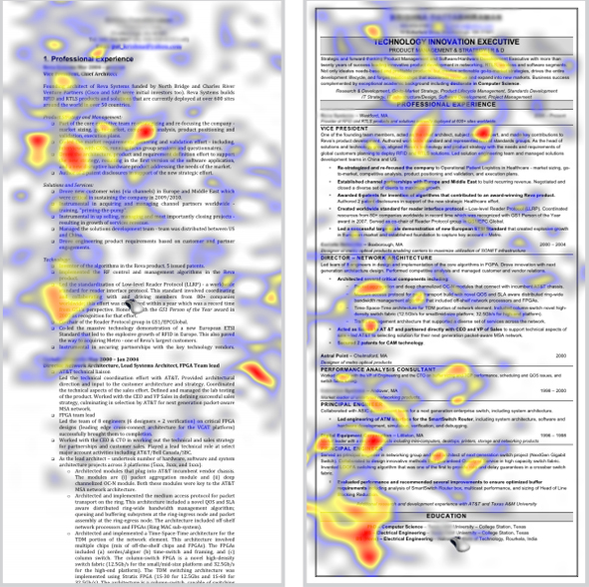
HOW A RECRUITER SCANS A RESUME

Slide 5
ANDERSON MFE TEMPLATE
One page only
Reverse chronological order
Font size: 10-12 point
Name is larger font: 14-16 point
Font style: Times, Calibri, Ariel
Margins: no smaller than ½ inch
Use action verbs for bullets points
Consistent format
Experience can be paid or unpaid.
It may include:
Internships
Academic or work projects
Leadership roles
Volunteer work

Slide 6


RESUMES
Concerned all your resumes will look the same to the employer?
They don’t - each of you has different backgrounds, experiences, skills, etc.
Your job is to write the resume in a way that targets your talent to the position
Here’s how……..

Slide 7
maximize Your Resume
Target the resume to the position of interest
show the connection between you and the job requirements
Determine 5-7 skills, experiences & traits that are important to your target audience (the employer)
Review the job posting and identify the skills and/or qualities the employer seeks, and you have.

Slide 8
maximize Your Resume
Demonstrate results and accomplishments where possible
Quantify when possible
Do not use pronouns: I, we
Use strong action verbs to begin each bullet point
Be thorough – don’t assume you will ‘explain it’ in the interview

Slide 9
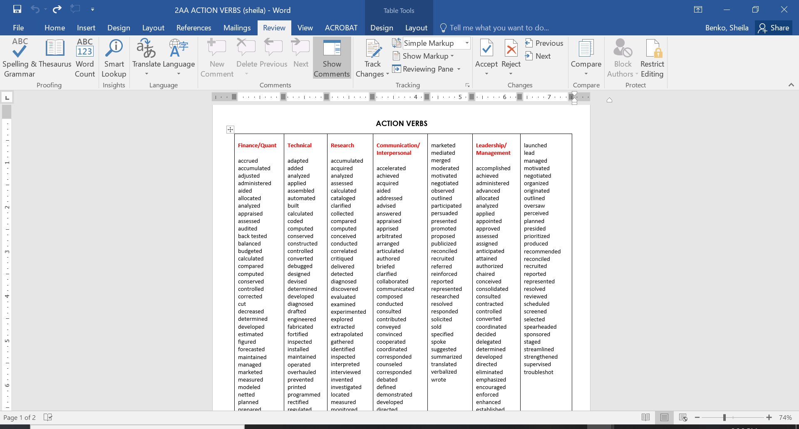

Slide 10
Situation – Action – Result
STRATEGY TO WRITE STRONG BULLET POINTS
S-A-R

Slide 11
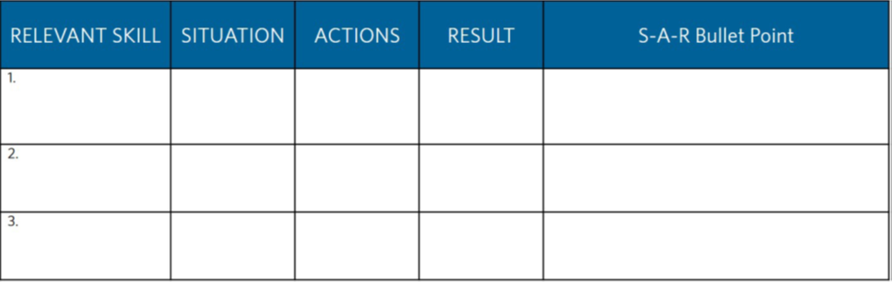
How to write a strong bullet point
Identify situations in which you demonstrated the skills you are emphasizing.
What action did you take? – start each bullet with an action verb
What were your results? Did a system improve? Did you exceed goals? Receive commendation?

Slide 12
IDENTIFY SAR IN THIS BULLET
Designed and created quasi-VaR (Value at Risk) tool using SQL, R & Shiny to evaluate risks faced by investors’ portfolios during market downturns

Slide 13
IDENTIFY SAR IN THIS BULLET
Designed and created quasi-VaR (Value at Risk) tool using SQL, R & Shiny to evaluate risks faced by investors’ portfolios during market downturns
Situation: during market downturns
Action: Designed and created quasi-VaR (Value at Risk) tool using SQL, R & Shiny
Result: to evaluate risks faced by investors’ portfolios
Write the phrase in a way that makes sense,
sharing the most important information first.

Slide 14
RETURN ON INVESTMENT (ROI)
Initiated coverage on Mexican financial sectors & Andean Region corporate sectors; recommended BBVA Bancomer’s sub debt into portfolio, generating a 10% return
Managed four-person team to conduct software audits for blue-chip hardware and software client ($50B market cap); identified over $40MM in breaches of contract, producing 6x ROI for client

Slide 15
improvement
Created a quantitative model in Python for an equity trading strategy, after proving the initial model produced a profitable strategy, adapted it to different markets and then advanced it from daily to an intraday model
Implemented an analytics platform and user interface for data anomaly detection using proprietary languages, allowing more accurate and efficient management of financial positions

Slide 16
INCREASED REVENUE/PROFITABILITY
Integrated user feedback and product knowledge and vision into refined requirements for data acquisition tools used by five product teams, powering more than 300 distinct client implementation totaling $120M in contract value
Management Buy-in
Performed a comprehensive evaluation of two PAAMCO asset managers’ risk profiles and trading patterns; presented report with findings and suggestions for improvement to PAAMCO’s Head of Portfolio Solutions

Slide 17
STILL STRUGGLING WITH RESULTS?
Ask yourself:
How did this fit into the overall company strategy?
What were you most proud of?
What problems were you able to solve?
What did you help create or build?
Describe to a friend what you did
Brainstorm your previous tasks & accomplishments
Dig up your performance reviews or original job description

Slide 18
Additional tips
No hanging words (when there are only one or two words on a line)
Six bullets max in a section
Consolidate early/less relevant work experience
Cut any bullets of tasks you no longer want to do
Adjust margins & font as a last resort

Slide 19
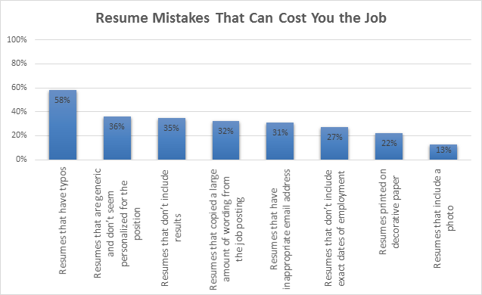
Typos!

Slide 20


How to Save Your Resume
REVISIONS
APPLICATIONS

Slide 21
Final review of resume
Prioritize the order of the bullets based on their relevance to the targeted company or position.
Target the resume to the job/internship
Proofread! No typos are acceptable. Have at least one other person review it for you.
Update your resume throughout the year as you take classes, acquire skills, do projects.

Slide 22
Access TO VMOCK
VMock is a 24/7 online resume review tool available for all UCLA students. It provides instant personalized feedback on your resume based on criteria gathered from employers and UCLA community standards.
https://career.ucla.edu/vmock
This tool is available once you SIR –
contact mfecareers@anderson.ucla.edu if you have questions

Slide 23
write Your Resume
Follow the examples for resume format for UCLA MFE
(handouts will be sent)
Submit your resume in Word document to me to permit revisions
final draft will be pdf
DO NOT use a template from the internet
Email draft for review to: mfecareers@anderson.ucla.edu
Document title: LastName_FirstName
First Draft Due June 11
Your resume will be reviewed and feedback provided

Slide 24
Action Steps
Draft of Resume due on June 11, 2021
Send in Word document (not pdf)
Title of resume document: Last Name_First Name
Send resume draft to Riana Olson by June 11.
mfecareers@anderson.ucla.edu

Slide 25
Q&A

